Slide 1

EDA for Wine Reviews
Akshay Joshi

Slide 2
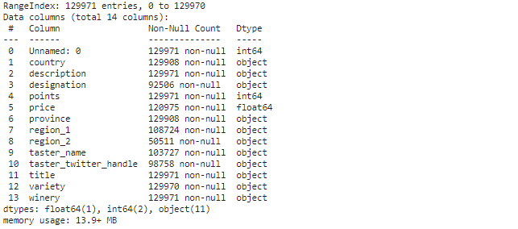
Data Reading
Entries – 129971 having 14 columns

Slide 3
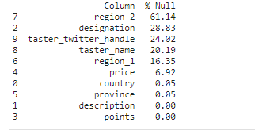
Null Values

Slide 4
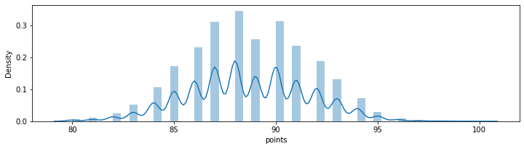
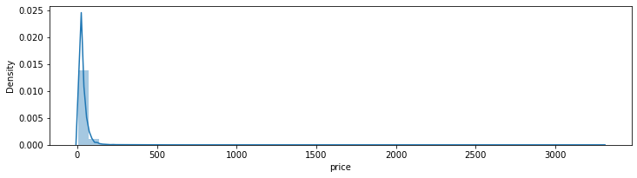
Numerical features distribution

Slide 5
Filling null values
Mean for numerical variables ( ‘price’ )
Mode for categorical variables ( ‘country’, ‘province’ )

Slide 6
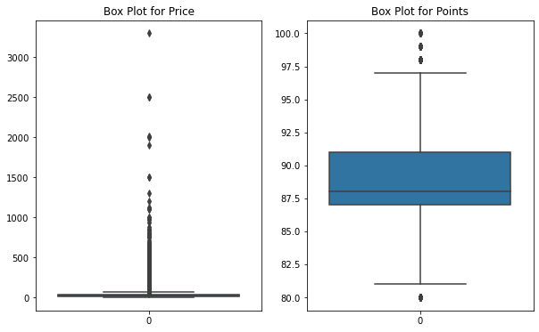
Checking outliers

Slide 7
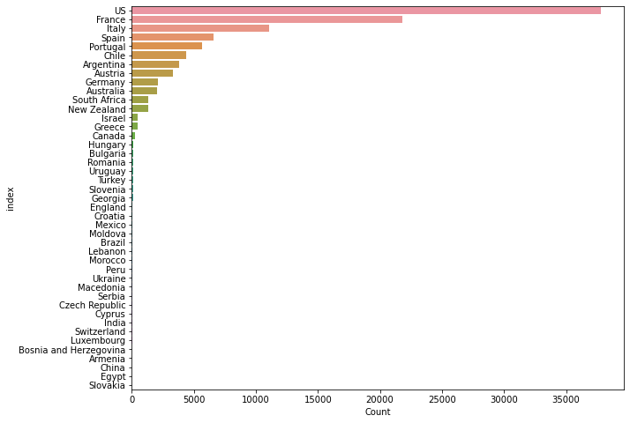
Checking categorical variables

Slide 8
Inferences
There are few outliers present for price and points features
From US country, collected most reviews.
Distribution of price feature is between 0-250
Points given by the reviewer are mostly between 85-92
All null values are replaced by Mean for numeric and Mode for categorical features

Slide 9
Questions and Answers

Slide 10
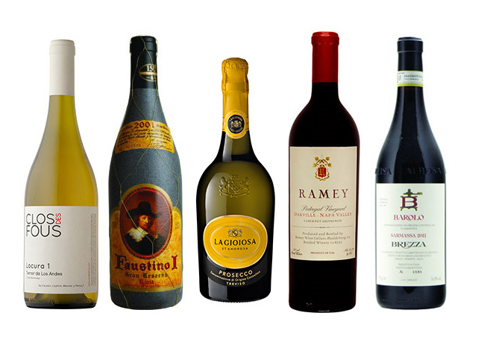
Thank You
☺

